Slide 1
EXPLORATORY DATA ANALYSIS OF UNICORN COMPANIES
PRESENTED BY
JAPHETH EHIJIE EROMON
MARCH COHORT 2023

Slide 2
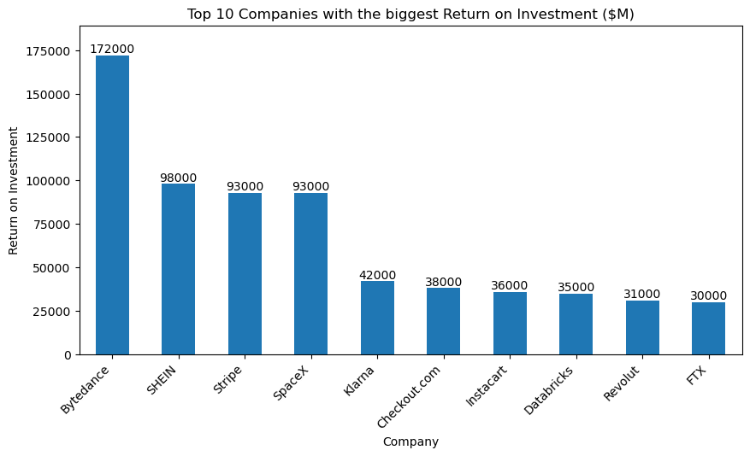
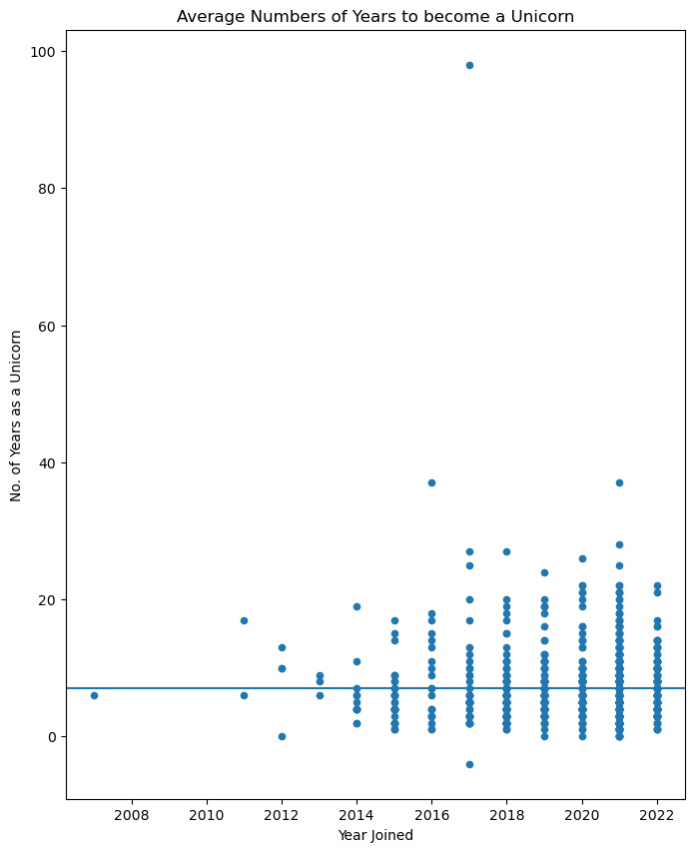
Which unicorn companies have had the biggest return on investment?
How long does it usually take for a company to become a unicorn? Has it always been this way?
Observation
- It is observed from the bar chart that Bytedance has the highest Return on Investment with a total of 172 billion dollars followed by SHEN with 98 billion dollars while the least top 10 companies is FTX with a Return on Investment of 30 billion dollars
Observation
It takes an average of 7 years to be a member of the Unicorn Companies

Slide 3
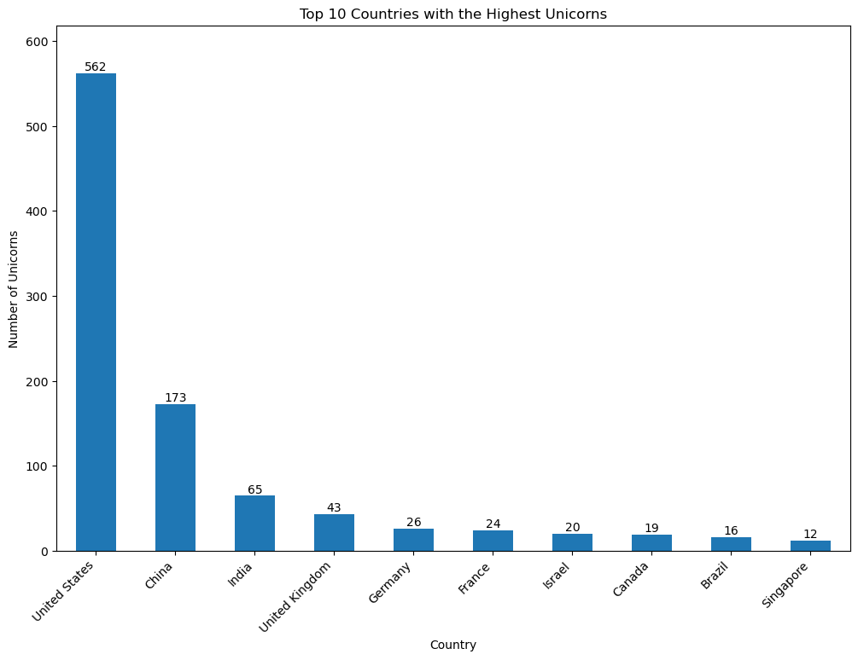
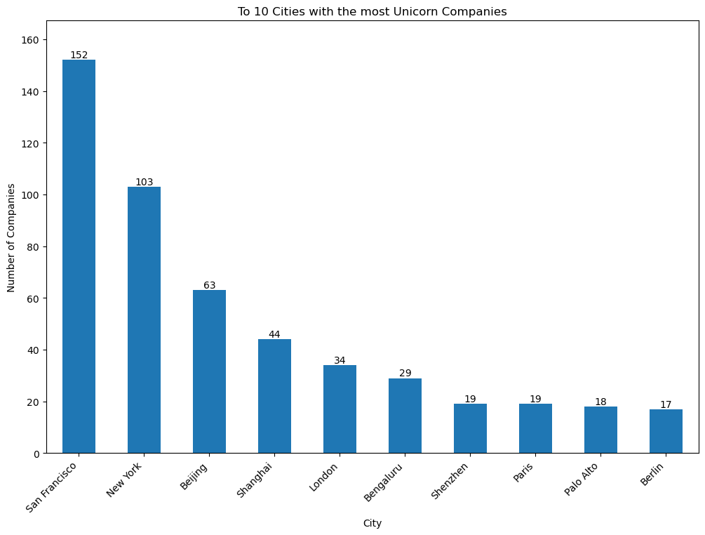
Which countries have the most unicorns?
Are there any cities that appear to be industry hubs?
Observation
United States have the highest number of Unicorns which is 562, followed by China with at total of 173 and India in third place with at total of 65 Unicorns
Observation
San Francisco, New York and Beijing topped the chart as the first three Cities with the most Unicorn Companies with a total of 152, 103 and 63 Unicorn companies respectively

Slide 4
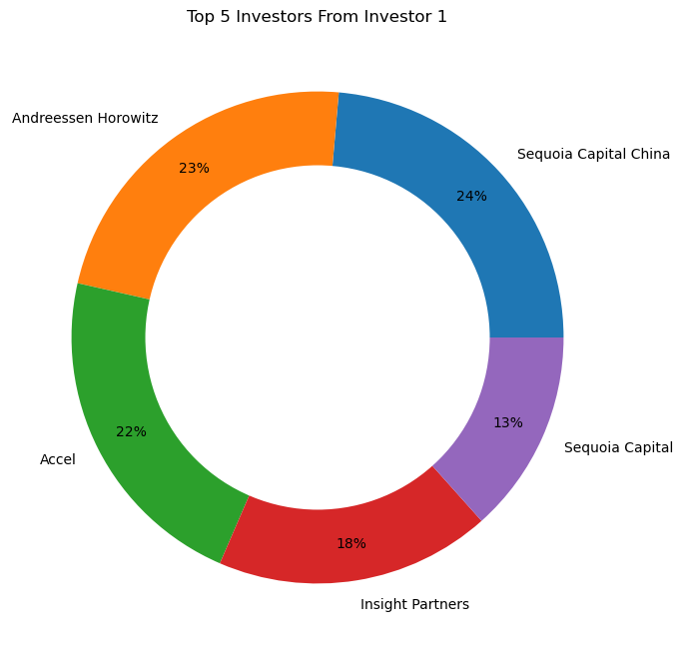
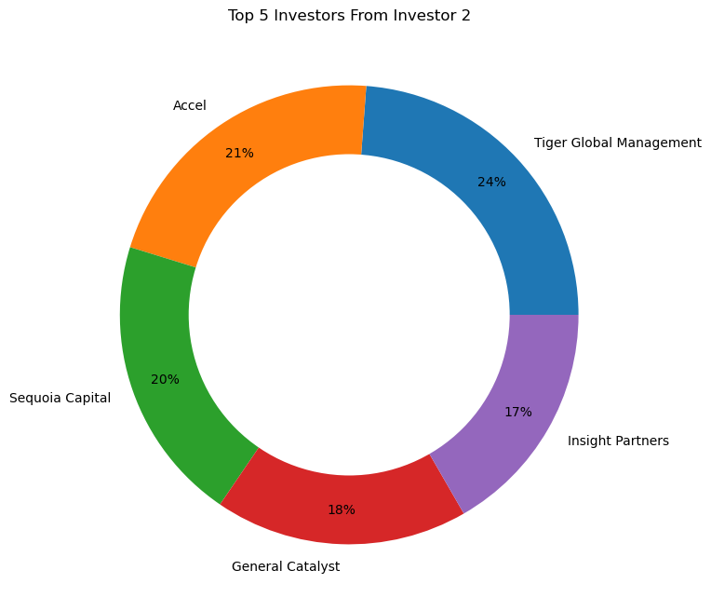
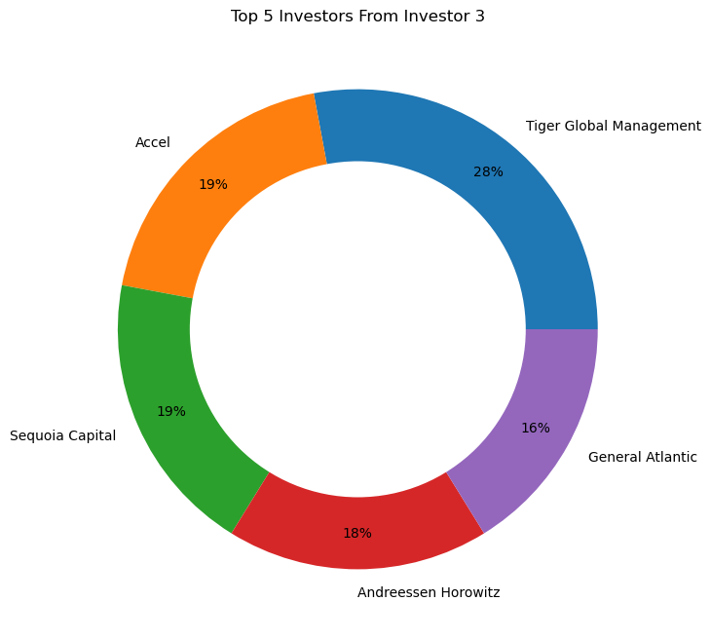
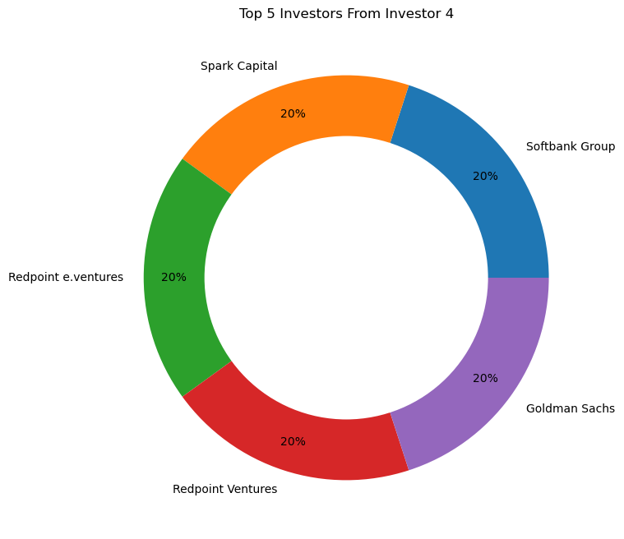
Which investors have funded the most unicorns?
Observation
For this purpose the Investors were split into Four (4) groups namely – Investor 1, Investor 2, Investor 3 and Investor 4.
From Investor 1 – Sequoia Capital China topped the group with 24% followed by Andreessen Horowitz (23%) and Accel (22%)
From Investor 2 – Tiger Global Management was first with 24% , followed by Accel (21%) and Sequoia Capital (20%)
From Investor 3 – Tiger Global Management was first with 28%, followed by Accel and Sequoia Capital both with 19% and Andreessen Horowitz (18%)
From Investor 4 – There was equal distribution of the investors amongst the top 5 investors.
Overall Top Investor Is ACCEL with an overall of 62% of the overall investment in the Unicorn Companies

Slide 5
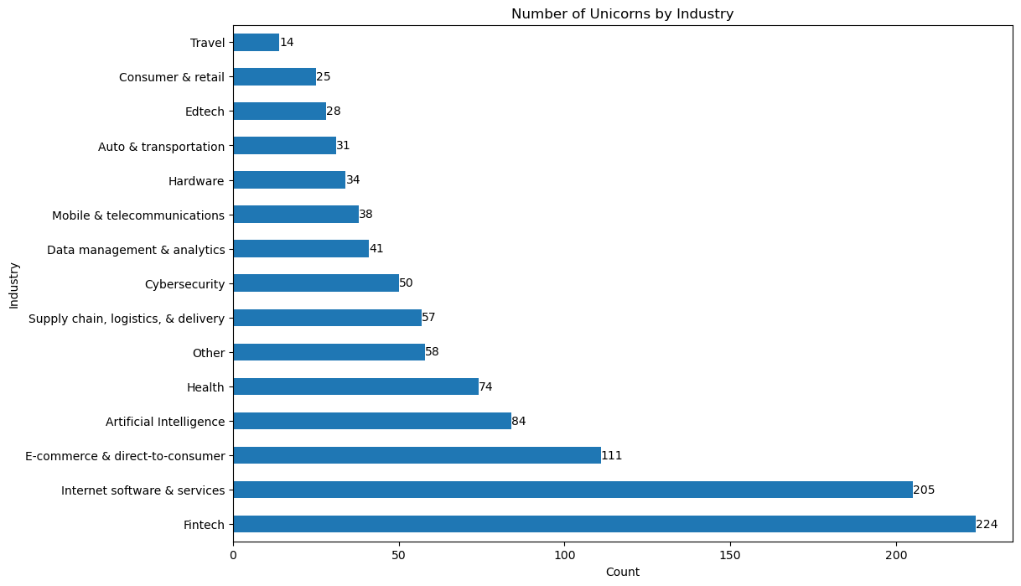
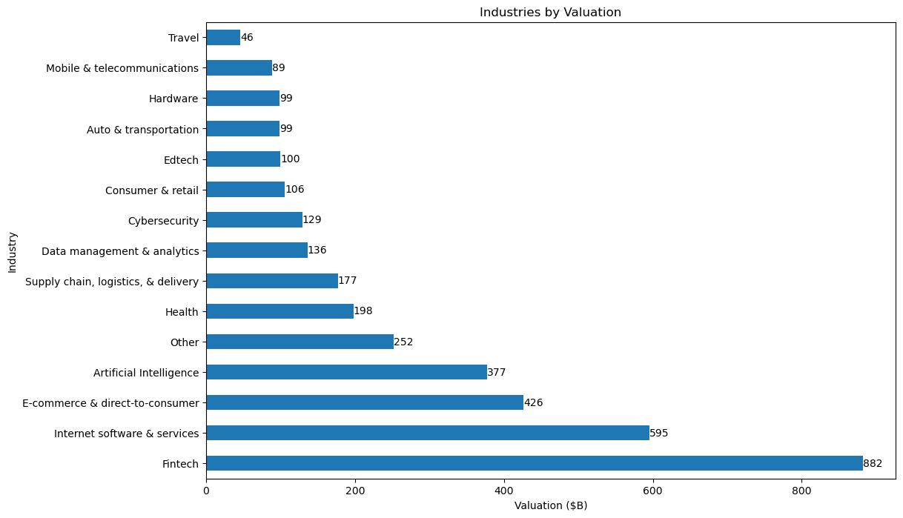
Which industry has the most Unicorns?
Which Industry produces the most value?
Observation
The Industry with the Highest Valuation in Billions is the Fintech Industry with a total value of 882 billion dollars followed by Companies in the Internet Software and Services with a total value of 595 billion dollars. The Least being the Companies in the Travel industry with a total value of 46 billion dollars.
Observation
The Fintech industry has the highest number of Unicorn Companies of 224 and the Travel Industry has the lowest of 14 Unicorn Companies.

Slide 6
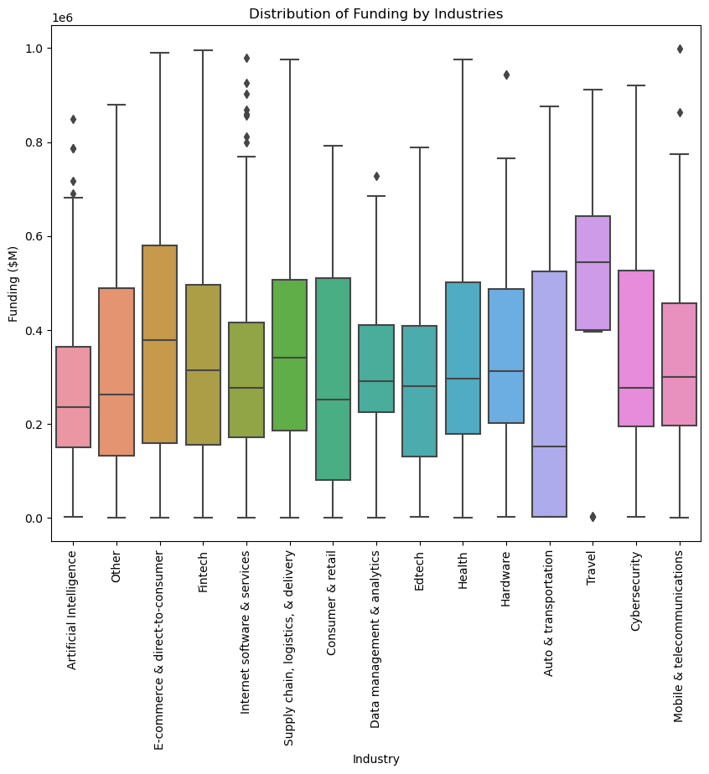
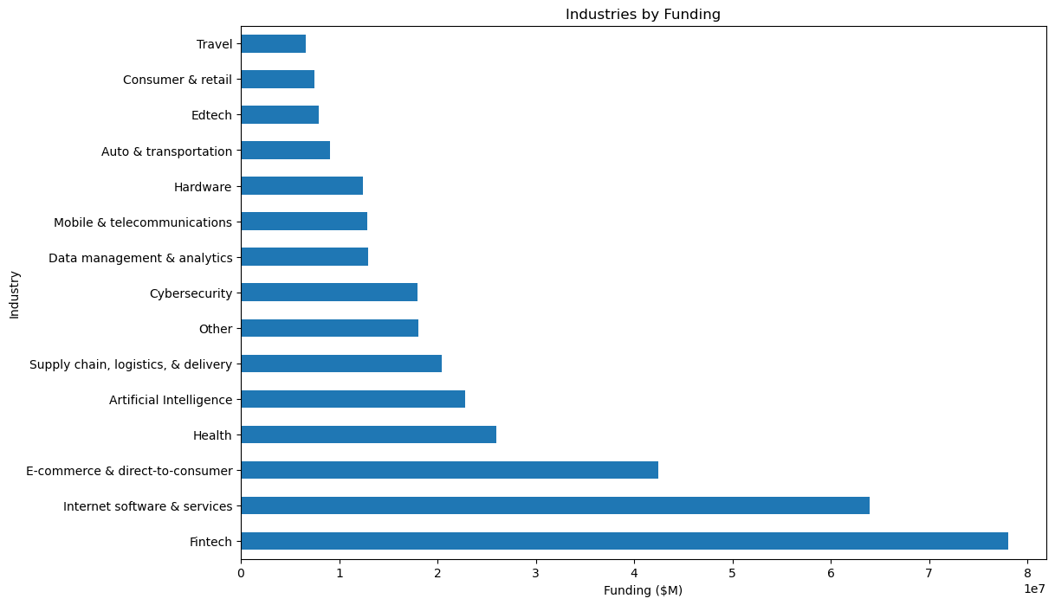
Distribution of Funding by Industry
Observation
we can see that the most funded Industries are those in the Fintech sector with the median funding of 300,000 million dollars, while the least funded Industries are those in the Data management and Artificial Intelligence sectors with a median funding of 250 million dollars and 210 million dollars respectively

Slide 7
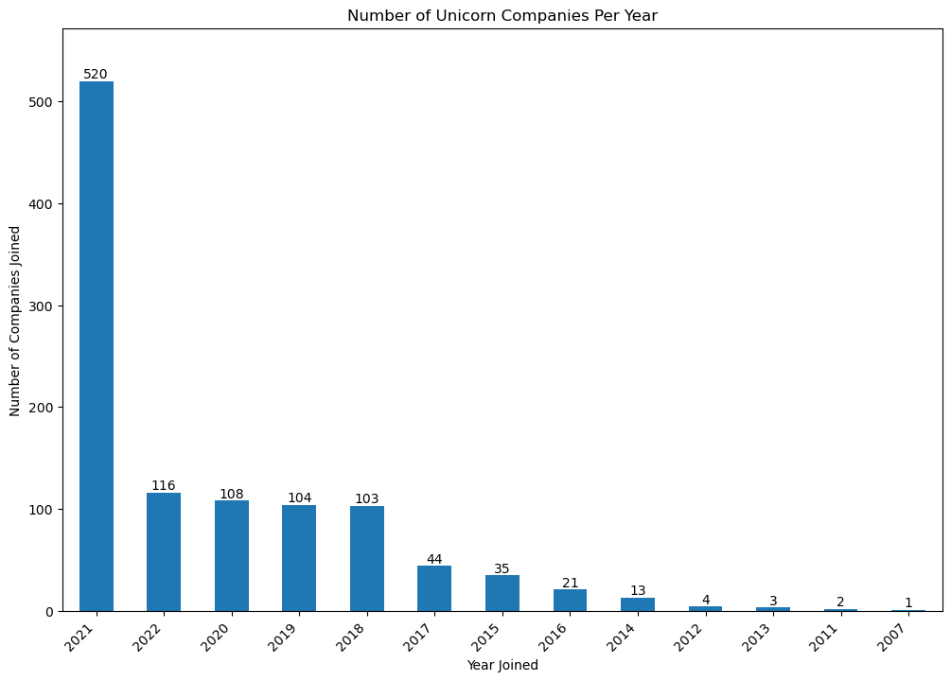
Number of Unicorn Companies per Year
Observation
From the dataset provided, the year 2021 saw the highest number of companies become Unicorn Companies with a total of 520 companies while 2007 was the least with just 1 company joining the Unicorn group.

Slide 8
(1) The Industry that produced the most value is the FINTECH industry with a valuation of 882 Billion Dollars. (2) The top four industries with high growth potential to focus on or diversify investment portfolio are the - Fintech - Internet Software and Services - Ecommerce & Direct-to-consumer - Artificial Intelligence (3) The United States seems saturated with lots of Unicorn Companies however, China is an emerging market and looks like an excellent economy to invest in
RECOMMENDATION

